Slide 1
American Health Policy 102: Understanding Medicaid and Recent/Current Policy Changes
NCIL Meeting
Washington, DC
July 25, 2018

Slide 2
The Collaborative on Health Reform and Independent Living (CHRIL)
Objective: To discover and share essential information about how health reforms affect working-age adults with disabilities.

Slide 3
CHRIL Institutional Members
Washington State University (WSU)
Independent Living Research Utilization (ILRU) at TIRR Memorial Hermann
University of Kansas (KU)
George Mason University (GMU)

Slide 4
CHRIL Strategic Partners
National Council on Independent Living (NCIL)
American Association on Health and Disability (AAHD)
Association of Programs for Rural Independent Living (APRIL)
Disability Research Interest Group (DRIG) of AcademyHealth
Urban Institute

Slide 5
An Introduction to Medicaid
Jae Kennedy
Washington State University
Spokane, WA

Slide 6
Early 60s efforts in health reform
Although the explosion in private employer-sponsored insurance in the 1940s and 50s covered most workers and their families, nonunionized retirees were usually out of luck
Congressional Democrats proposed federal hospital insurance as part of Social Security benefits, arguing that retirees can’t have income security if they get bankrupted by a large hospital bill
AMA and Republican allies opposed mandatory coverage of all Social Security recipients, proposed voluntary plan which would cover physician as well as hospital costs

Slide 7
Social Security Amendments of 1965
Johnson White House and Congress compromise:
Medicare part A – hospital insurance (mandatory federal benefit)
Medicare Part B – physician and other medical coverage (optional federal benefit)
Medicaid – hospital and medical services for the poor (state-administered benefit with variable eligibility and coverage)

Slide 8
Medicaid is a lot different than Medicare
Reflected ambivalence of federal policy toward the poor: program eligibility determination and administration left to states
Federal matching requirements: more populated and progressive states provided more services, others provided very little
Program never managed to meet needs of large group of uninsured (i.e. the working poor and their families)
Federal funding undermined rationale for public community hospitals

Slide 9
Medicaid, 1966-2010
Extended eligibility to adults and children enrolled in the new Supplemental Security Income (SSI) program in 1972
Coverage of core inpatient, outpatient, physician and nursing home coverage was required, but most states opted to provide additional coverage for a variety additional services, including PAS
In 1997, the State Children’s Health Insurance Program (SCHIP) gave states an enhanced match to increase coverage for low-income children and pregnant women

Slide 10
The Affordable Care Act’s Medicaid eligibility expansion
Originally under the 2010 ACA, states must provide Medicaid to all individuals under age 65 with incomes below 139% of federal poverty level
In 2012, the Supreme Court concluded that enforcement of the Medicaid expansion was an unconstitutional violation of states’ rights
Consequently, while states still may choose to increase Medicaid income eligibility to 138% of the FPL and eliminate categorical requirements, they are not required to do so

Slide 11
34 States have Expanded Medicaid Eligibility as of July 2018
WA
VT
ME◊
MT*
ND
MN
NH*
OR
MA
SD
WI
NY
ID‡
MI*
CT
RI
WY
PA
NJ
NE‡
IA*
OH
DE
NV
IL
IN*
MD
CA
UT‡
CO
WV
VA◊
KS
MO
KY^
DC
NC
AZ*
TN
NM
OK
AR*
SC
MS
AL
GA
AK
TX
LA
FL
HI
Adopted (34 States including DC)
Considering Expansion (3 States)
Not Adopting At This Time (14 States)
Notes:
Description: Map of US shows the 34 states that have adopted the Medicaid Expansion, the 3 states that are considering expansion, and the 14 states that are not adopting expansion at this time
SOURCE: “Status of State Action on the Medicaid Expansion Decision,” KFF State Health Facts, updated July 3, 2018.
https://www.kff.org/health-reform/state-indicator/state-activity-around-expanding-medicaid-under-the-affordable-care-act/

Slide 12
Medicaid Managed Care
Jean Hall
University of Kansas

Slide 13
Medicaid Managed Care is Growing
Currently, 39 states have at least some Medicaid enrollees in managed care programs
The majority of Medicaid enrollees nationally receive all or part of their Medicaid services through a managed care program
Use of managed care continues to grow and states are increasingly moving people with disabilities into managed care arrangements
States use managed care to decrease costs and also to add more predictability to costs

Slide 14
Which Medicaid enrollees are most expensive?
Notes:
This graphic shows the proportion of different groups enrolled in Medicaid and their proportion of costs.
Other Children: 48 percent of enrollees, 21 percent of costs
Other Adults: 27 percent of enrollees, 15 percent of costs
Seniors: 9 percent of enrollees, 21 percent of costs
Children with disabilities: 2 percent of enrollees, 7 percent of costs
Nonelderly adults with disabilities: 12 percent of enrollees, 36 percent of costs
From the Kaiser Family Foundation

Slide 15
Where is the money spent?
Notes:
This graphic shows the annual spending on acute care versus long-term care for different types of Medicaid enrollees.
Other Children: $2399 on acute care, $64 on long-term care
Other Adults: $3234 on acute care, $13 on long-term care
Children with disabilities: $13591 on acute care, $3211 on long-term care
Nonelderly adults with disabilities: $9922 on acute care, $6690 on long-term care
Seniors: $4091 on acute care, $9158 on long-term care
From the Kaiser Family Foundation

Slide 16
Surveys of Kansas Medicaid Enrollees with Disabilities – Problems noted
Provider Networks*
“None of the providers I have seen for years in Jackson County Missouri takes KanCare [KS Medicaid managed care].”
“Speech therapy is a two and a half month wait because there’s only one provider for my MCO.”
Benefits/Coverage
“Can’t get [medication], so I am just not taking it. I need it though.”
“I had to pay $700 to get a joystick on my new wheelchair; they [MCO] won’t cover it even though I’m a quad[riplegic].”
Step Therapy and Preauthorization for prescriptions are especially problematic for people with mental health conditions—32% reported not taking at least one prescribed medication
  *In 2017, CMS noted the state does not provide sufficient data on adequacy of networks

Slide 17
Problem areas, continued
Transportation
  “The transportation people don’t transfer me correctly and I’ve gotten hurt.”
  “My PCA [attendant] can’t get paid to go along with me.”
  “My doctor’s office changed my appointment time, but the MCO won’t change the pickup time because it is not 3 days notice.”
Communication*
  “The 800 number tells you to go online, but they don’t realize that not everyone has internet access.”
  “I am completely confused about KanCare, I get things in the mail and I don't understand them.”
  “The information book they send is so thick plus I can't read it with my vision issues, even with my glasses and magnifier it is difficult.”
  *In 2017, CMS found the state to be out of compliance regarding information for consumers

Slide 18
Problem areas, continued
Care Coordination
All HCBS waiver participants are assigned a Care Manager/Coordinator with their MCO; 50% of survey respondents did not know who their coordinator was.
“I had more direct contact with my case manager before [managed care]. Now, I have to call a number, leave a message – which doesn’t always get to the care coordinator – and then wait. There is no way to directly contact them.”
“You have one [coordinator] for medical, but I don’t have someone for everything else, like problems with my wheelchair or housing.”
Less than 20% of respondents with SMI reported working with a care coordinator, despite the fact that 73% had co-occurring physical illnesses or conditions, including diabetes and heart disease.

Slide 19
Conclusions
Medicaid managed care organizations (MCOs) may not be fully prepared to meet the unique needs of people with significant disabilities
Medical issues include lack of broad provider networks, coverage limits
Non-medical issues include transportation and communication
LTSS, including care coordination, are essential to maintaining the health and function of people with disabilities
General lack of disability cultural competence and awareness of accessibility issues

Slide 20
Implications for Policy & Practice
Gaps in care due to difficulties obtaining services and supports can quickly lead to adverse outcomes for people with disabilities and increased costs for Medicaid programs
With the nationwide trend in moving people with disabilities to managed care, MCOs must have the capacity to best serve these individuals
Utilization of disability-related measures of access and quality of care are needed
Outcomes for Medicaid beneficiaries with disabilities must be monitored closely and separately

Slide 21
Home and Community Based Services (HCBS) Waivers
Noelle Kurth
University of Kansas

Slide 22
HCBS Waiver Facts and Figures
Waivers vary widely from state-to-state with the average cost per enrollee being $18,500
Currently, there are about 400 different waivers providing services to 1.5 million people across the country
States have to submit new waivers to CMS for approval as well as renew existing waivers periodically
Enrollment in waivers continues to increase each year and with the costs associated, HCBS waivers are a target for cuts and modifications
75% of states (39 of 51) have waiting lists for waiver services that equal over 650,000 individual

Slide 23
HCBS Waiver Facts and Figures, continued
States that expanded Medicaid under the ACA have less people on waiting lists, 8 have no waiting lists.
49 out of 51 states offer self-direction as part of their waivers (Arkansas and Nevada do not)
54% of waiver enrollees are in a waiver for seniors or non-elderly adults with physical disabilities
42% of waiver enrollees are in waivers for adults or children with IDD
The remaining 4% are split between waivers for those with HIV/AIDS, mental illness, TBI, SCI or assistive technology needs

Slide 24
Medicaid Financing Reform and Work Requirement Waivers
Gilbert Gimm, PhD
Associate Professor
George Mason University
Fairfax, VA
NCIL Conference
July 2018

Slide 25
Summary Overview of Key Points
Medicaid block grants and per-capita caps have been proposed as alternative financing strategies, but could have adverse effects on access to care for people with disabilities.
Work requirements for Medicaid eligibility have received CMS approval in at least four states (Arkansas, Indiana, Kentucky and New Hampshire) as of May 2018.
Although individuals with disabilities are exempt from the Medicaid work requirement, it may be difficult for states to implement these exemptions automatically.

Slide 26
Current Medicaid Financing
Medicaid guarantees that all people who are eligible (i.e., meet a state’s income and asset thresholds) can receive Medicaid coverage.
  A state is not allowed to impose waiting lists for Medicaid or turn away eligible people.
States receive matching funds (between 50%-73%) from the federal government for every dollar spent on Medicaid services.
  Uncapped spending provides flexibility so in an economic recession, a state continues to receive matching funds.

Slide 27
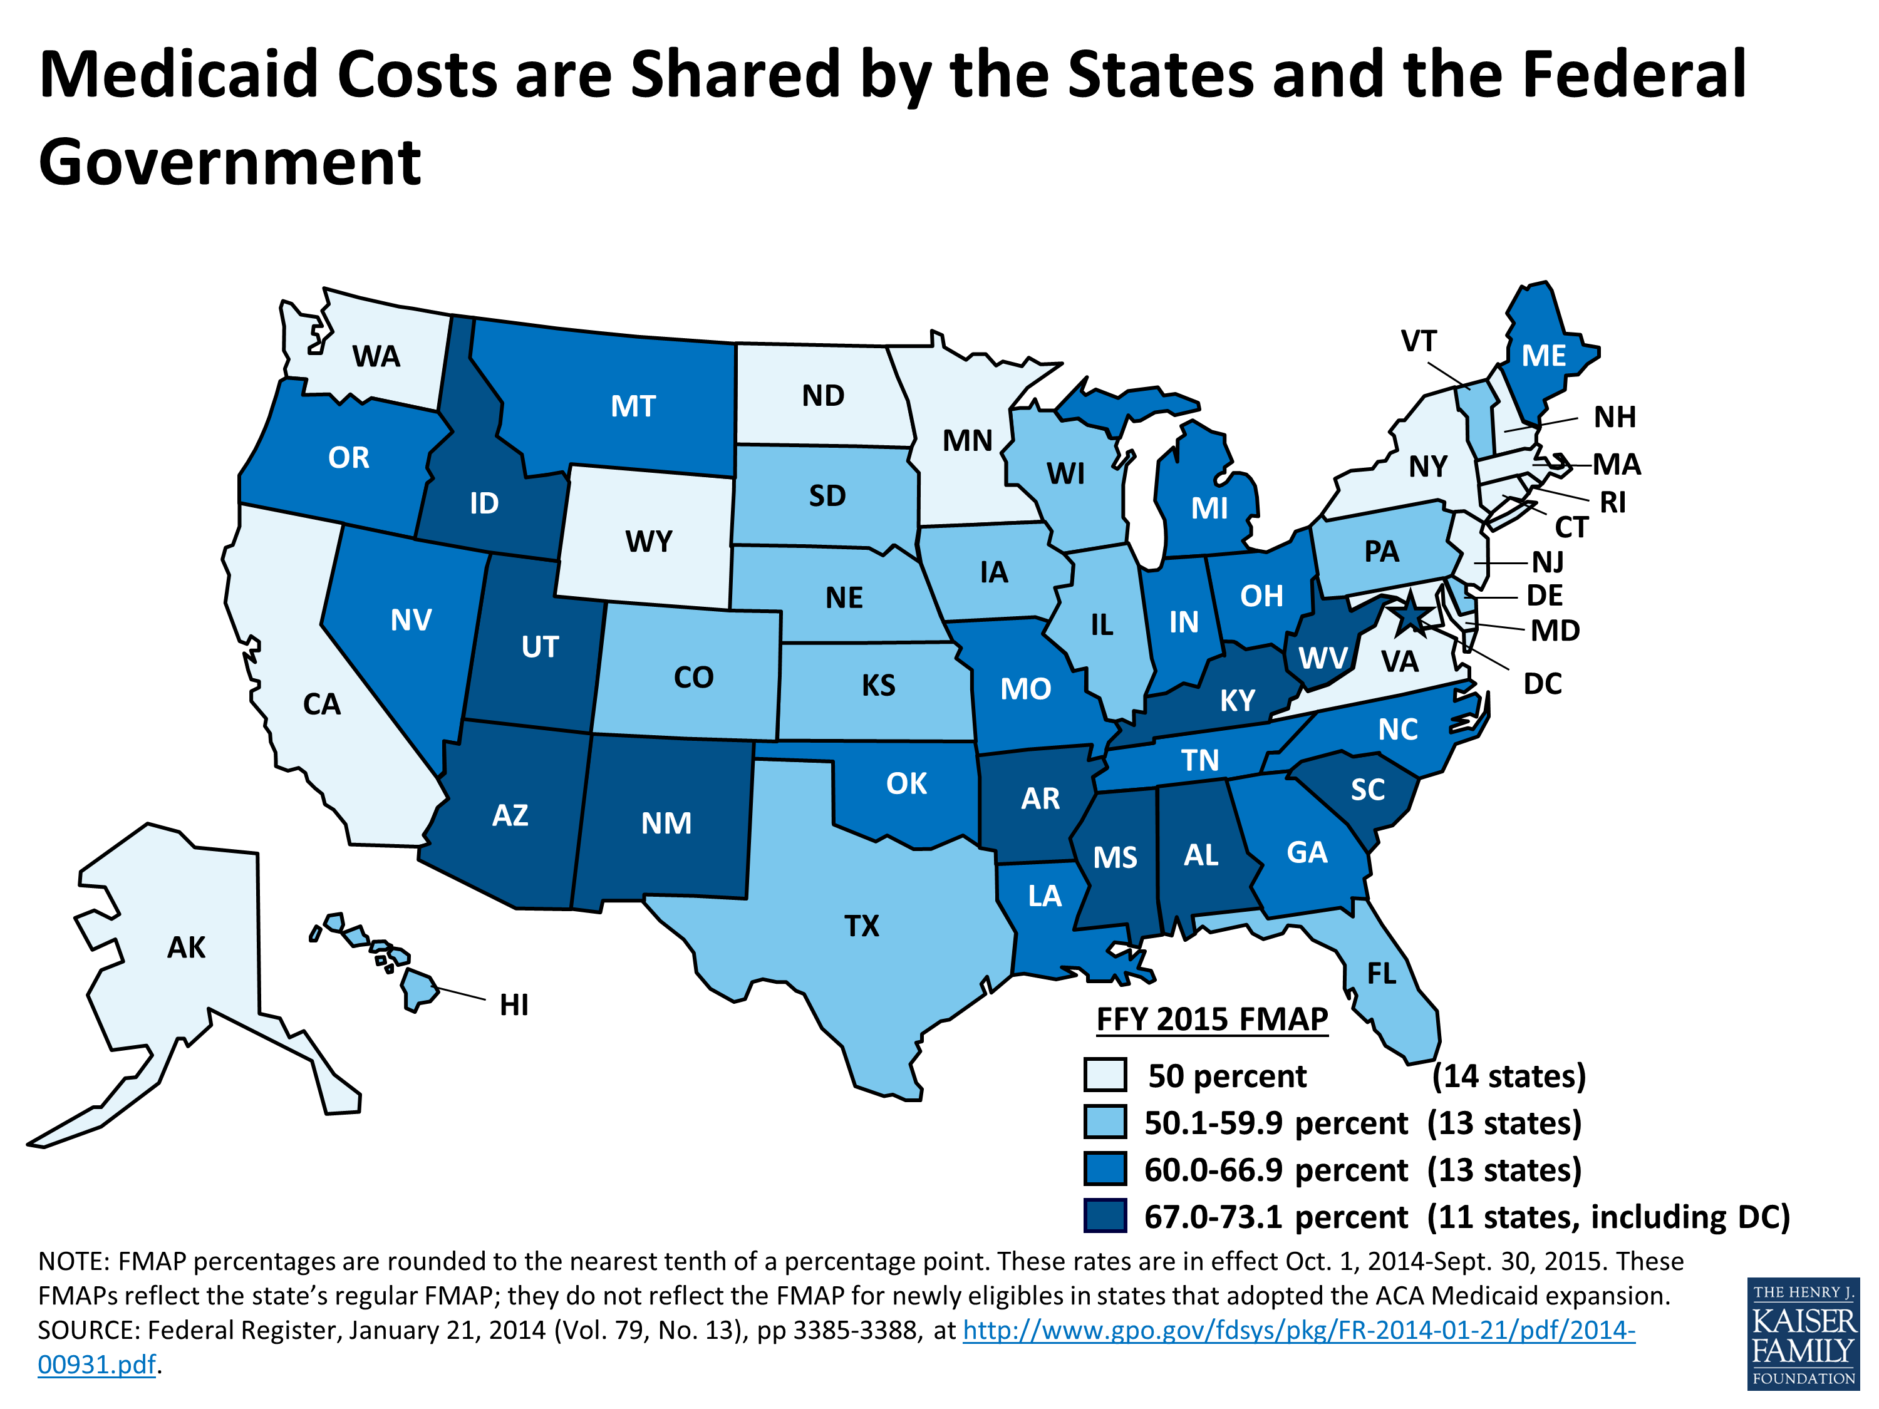
Notes:
Medicaid costs are shared by the federal government and states.
This graphic shows the 2015 Federal Medicaid Assistance percentages (FMAP) by state, which is also known as the federal matching rate.
14 States, including Virginia, New York, and California had a 50 percent federal matching rate, which is evenly split between the federal and state government.
13 States had a federal matching rate between 50 percent and 60 percent.
13 States had a federal matching rate between 60 percent and 67 percent.
10 States and the District of Columbia had the highest matching rate between 67 percent and 73 percent.
Source is from the Kaiser Family Foundation

Slide 28
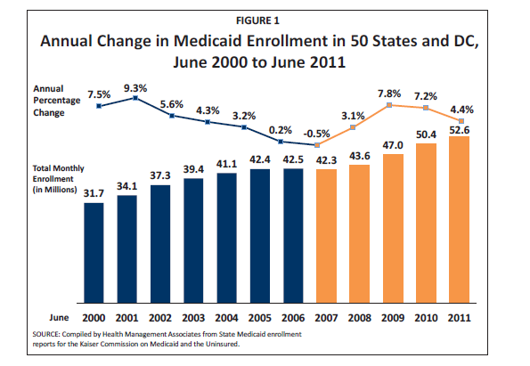
Medicaid Enrollment is “Countercyclical”
Notes:
This graphic shows total Medicaid enrollment nationwide from the year 2000 until 2011.
Enrollment increased from 32 million people in 2000 to 53 million people in 2011. Over this period, Medicaid enrollment growth was faster during economic recessions, in 2001 and 2008. For example, Medicaid enrollment grew by 9.3 percent between 2001 and 2002; and grew by 7.8 percent between 2008 and 2009.
Medicaid enrollment is “countercyclical” because Medicaid enrollment growth is faster when the economy weakens, but Medicaid enrollment growth is slower when the economy is strong.
Source is from the Kaiser Family Foundation.

Slide 29
What is a Block Grant?
Block grants are fixed federal grants to states over a period of time (i.e., year), indexed to inflation & state population growth.
However, as the number of enrollees rises (e.g., recession), less funding is available per enrollee.
If program costs exceed allocated funds before the end of the year, a state may need to cut Medicaid reimbursements, tighten eligibility, add waiting lists, or reduce benefits.
  Example: State Children’s Health Insurance Program (S-CHIP)

Slide 30
What is a Medicaid Per Capita Cap?
Total Medicaid spending and number of enrollees would both be calculated in a state for a given base year
  Divide total spending by number of enrollees to calculate the initial amount per person, or per capita (enrollee) amount
This amount is adjusted by inflation in future years
  The new inflation-adjusted per enrollee cap is multiplied by a state’s total Medicaid enrollment to compute federal Medicaid payments to a state. But new technology or the rising prevalence of chronic health conditions would not be reflected in the cap.

Slide 31
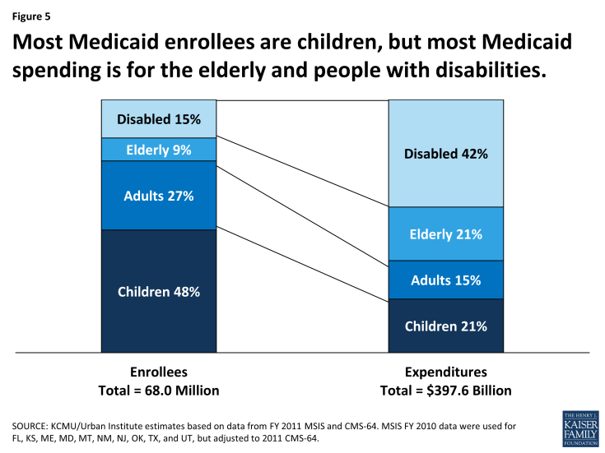
Medicaid Enrollees with Disabilities
Account for Over 40 Percent of Spending
Notes:
This graphic shows that people disabilities represented only 15 percent of all Medicaid enrollees, but incurred more than 40 percent of all Medicaid spending.
However, children represent almost 48 percent of all enrollees, but incur only 21 percent of all Medicaid spending.
As a result, states are more concerned with Medicaid spending growth for adults with disabilities.
Source is the Kaiser Family Foundation.

Slide 32
Medicaid Work Requirements
(CMS Guidance as of January 2018)
“CMS is announcing a new policy designed to assist states in their efforts to improve Medicaid enrollee health and well-being through incentivizing work and community engagement among non-elderly, non-pregnant adult Medicaid beneficiaries who are eligible for Medicaid on a basis other than disability.” (CMS memo, Jan 2018)
“Medicaid work requirement proposals would require beneficiaries to verify their participation in approved activities, such as employment, job search, or job training programs, for a certain number of hours per week in order to receive health coverage”. (KFF, 2018)
Notes:
Source: Musumeci M. et al. KFF Issue Brief, Jan 2018

Slide 33
Example: Kentucky’s Section 1115 Waiver Demonstration
Kentucky’s work requirement was the first approved by CMS (Jan 2018). Expected to start on July 1, 2018.
  It requires enrollees to document 80 hours of work per month (i.e., 20 hours per week) or qualifying work activities, such as volunteering or job training.
  Enrollees who do not meet the work requirement in a given month can make up the missed hours the next month. Otherwise, coverage is dropped.

Slide 34
Medicaid Work Requirements – Page 2
(CMS Guidance as of January 2018)
“CMS recognizes that individuals eligible for Medicaid on a basis other than disability (and are therefore classified as “non-disabled”) may have a disability under the definition of the Americans with Disabilities Act...”
  “[State] modifications must include exemptions [for] individuals unable to participate for disability-related reasons…[or who need] support services to participate….

Slide 35
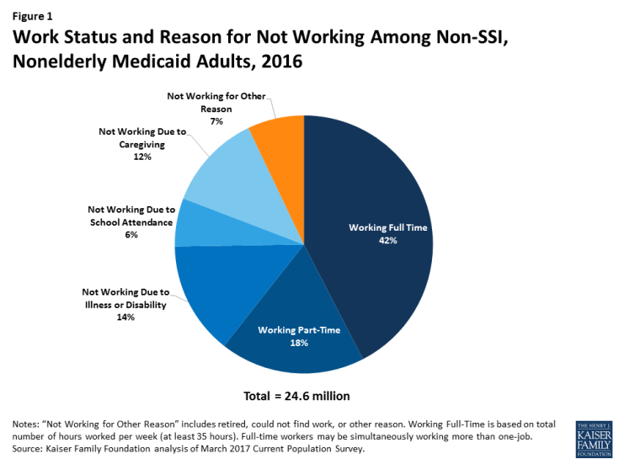
At Least 7 Percent of Non-Elderly Medicaid Enrollees Would Be Directly Affected
Notes:
This graphic shows that 7 percent of non-elderly Medicaid enrollees without SSI would be directly affected by a work requirement.
Also, 14 percent of this population is not working due to an illness or disability.
Source: Kaiser Family Foundation.

Slide 36
But More Medicaid Enrollees Can be Indirectly Affected by Work Requirements
States will need complex systems to handle the reporting and exemption process. (KFF, 2018)
  in practice, it will be difficult for many state Medicaid agencies to implement work requirement exemptions for people without SSI.
CMS guidance is explicit in that states may not use federal Medicaid funds for support services (e.g., transportation, education, job training) to help people overcome barriers to work.
Notes:
Source: Garfield R. et al. KFF Issue Brief, June 2018

Slide 37
Contact Information
www.chril.org
Twitter.com/reform_ability
Disability and Health Insurance Online Self-Paced Tutorial
  (or http://www.chril.ilru.org/training)
jjkennedy@wsu.edu

Slide 38
Acknowledgements
The Collaborative on Health Reform and Independent Living (CHRIL) is funded by a grant from the National Institute on Disability, Independent Living and Rehabilitation Research (NIDILRR), US Department of Health and Human Services
The contents of these presentations do not represent the policy of NIDILRR, ACL, HHS, or the US Government.

